Slide 1
WINE-QUALITY-PREDICTION
Data Analysis & Machine Learning Using Python Internship

Slide 2
TEAM MEMBERS
Shwetank Dixit
Srishti Rastogi
Team Name: The Brainiacs

Slide 3
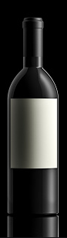
OUTLINE
1. Dataset Description
2. Preprocessing of Data
3. Data Visualization
4. Applying Machine Learning Algorithms
5. Building an Interface

Slide 4
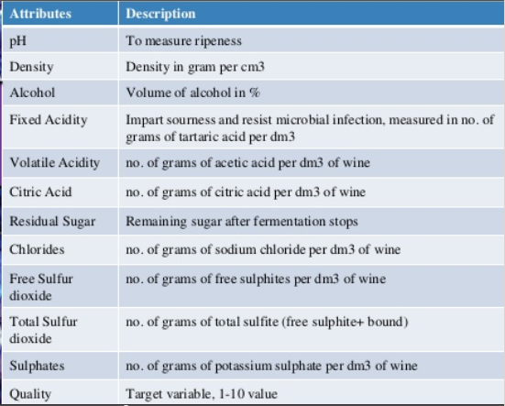
DATASET DESCRIPTION
We have taken our datasets from UCI Machine learning Repository.
Two datasets are included, related to red and white vinho verde wine samples, from the north of Portugal.
• The dataset has 12 attributes of each wine and 1 Output variable Quality

Slide 5
Structure of Data set
There are 1599 observations in the dataset with 12 variables.
The 12 features and their short description is as follows:
Fixed acidity: most acids involved with wine or fixed or nonvolatile (do not evaporate readily)
Volatile acidity: the amount of acetic acid in wine
Citric acid: mostly used for adding flavor
Residual sugar: the amount of sugar remaining after fermentation stops and measured in gms of sugar per liter.
Chlorides: the amount of salt in the wine
Free sulfur dioxide: the free form of SO2 exists in equilibrium between molecular SO2 (as a dissolved gas) and bisulfite ion; it prevents microbial growth and the oxidation of wine
Total sulfur dioxide: amount of free and bound forms of S02
Density: the density of alcoholalcohol is close to that of water depending on the percent alcohol and sugar content
pH: describes how acidic or basic a wine is on a scale from 0 (very acidic) to 14 (very basic); most wines are between 3-4 on the pH scale
Sulphates: a wine additive which can contribute to sulfur dioxide gas (S02) levels, which acts as an antimicrobial and antioxidant
Alcohol: the percent alcohol present in the wine
Quality: rating of the wine between 0-10 in the given sample.

Slide 6
Data Pre-Processing
Data Collection and Data Cleaning
Load The data
Describe the data in multiple- way
Remove Insignificant columns
Check Missing value for each columns
Remove rows with missing values

Slide 7
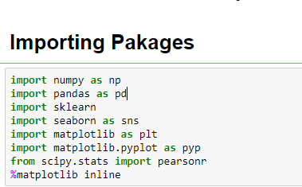
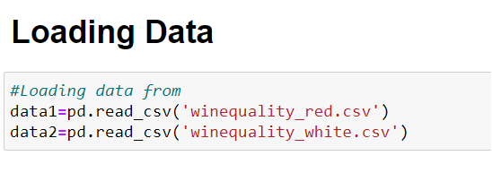
Load The data
We have imported all the packages needed for analysing the data.
Then, we have loaded the dataset, i.e 2 datasets of red wine and white wine.
Since we have 2 datasets, we need to merge the 2 datasets to form a single dataset and qualify the wine as ‘High’, ‘Average’ and ‘Low’.

Slide 8
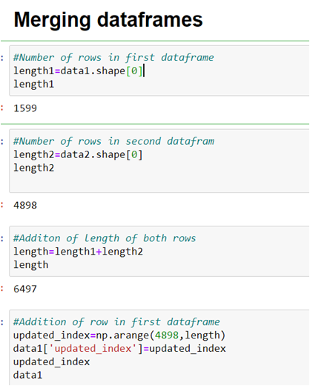
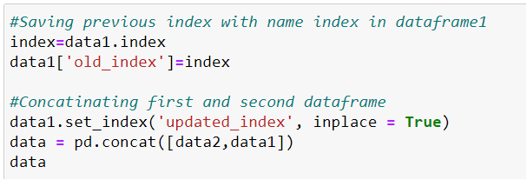
Merging DataFrames

Slide 9
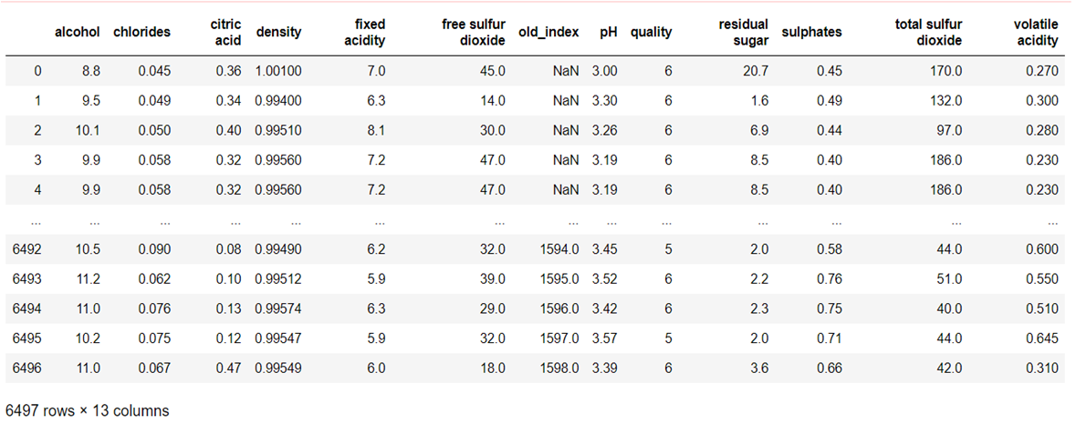
The final dataset after merging has 6497 rows and 13 columns.
The red wine dataset had 1599 rows and White wine dataset had 4898 rows individually.

Slide 10
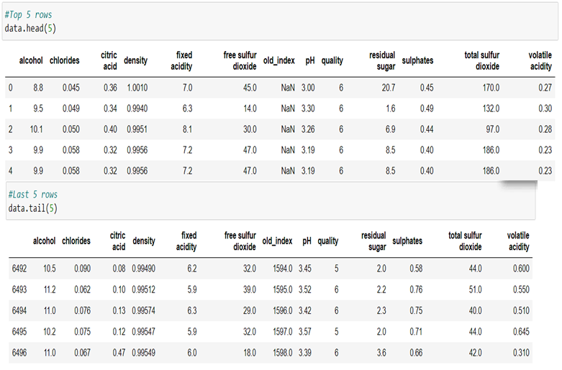
Describe the data

Slide 11
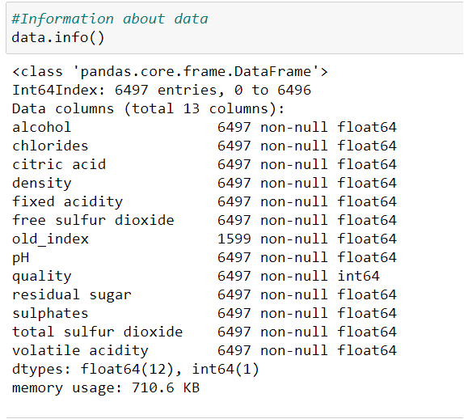
Describing the dataset using info function()
As we can see there are 6497 non-null float64 values on all data columns except column named old_index .
We will convert all null values of old_index column into -1 so that we can set a difference between both dataframes

Slide 12
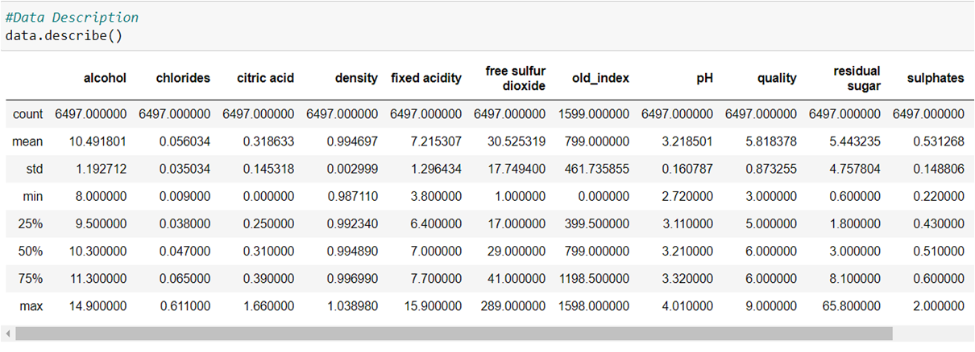
•Describing the data using describe()
•

Slide 13
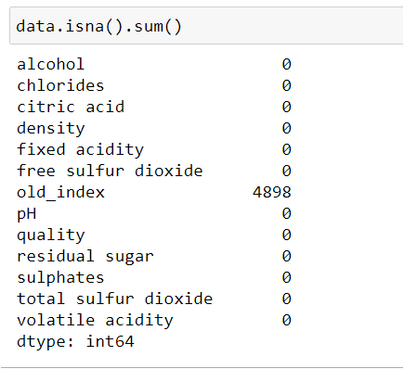
Check Missing value for each columns
We have 4898 nan value in old_index column.

Slide 14
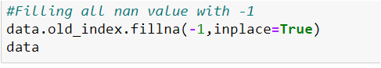
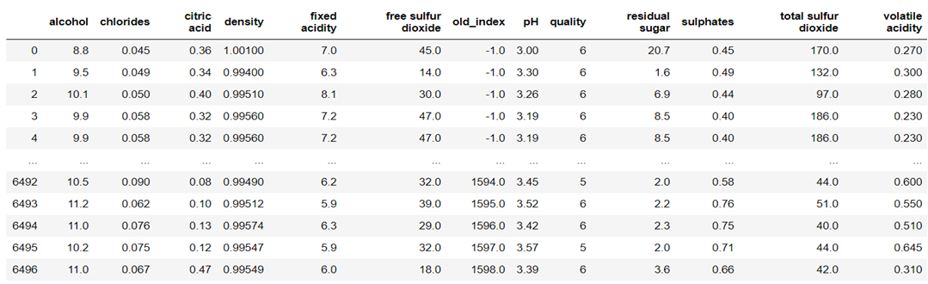
Filling rows with missing values
We will convert all null values of old_index column into -1 so that we can set a difference between both dataframes.

Slide 15
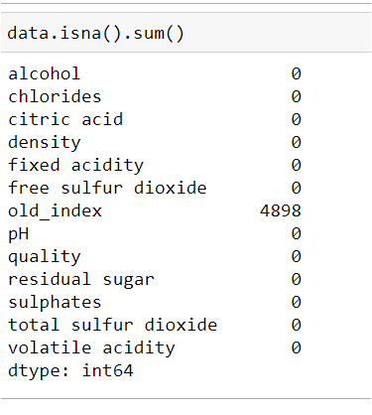
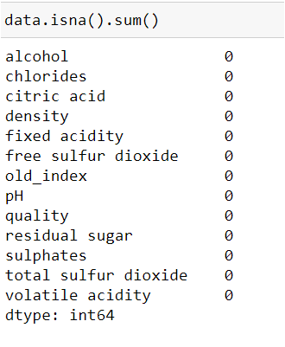
Before
After

Slide 16
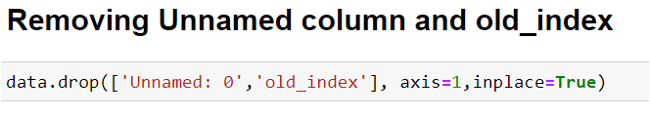
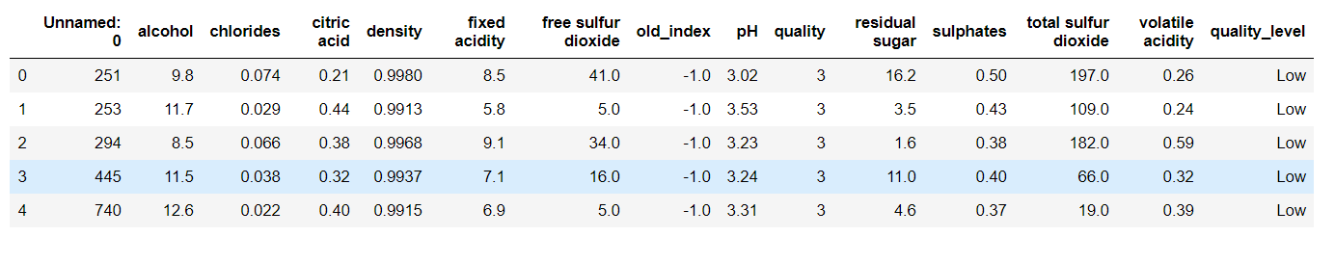
Remove Insignificant columns
•There are two insignificant columns: Unnamed :0 , old index
Before removal

Slide 17
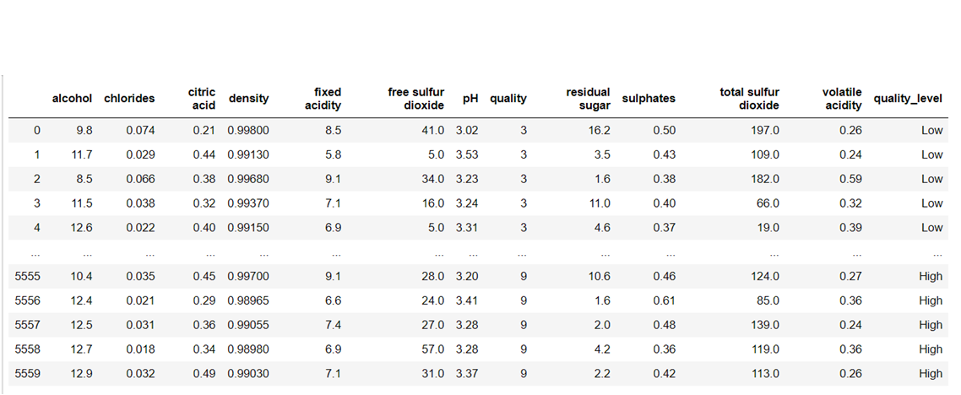
After Removal of unwanted columns

Slide 18
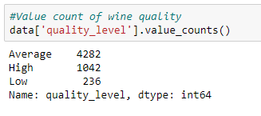
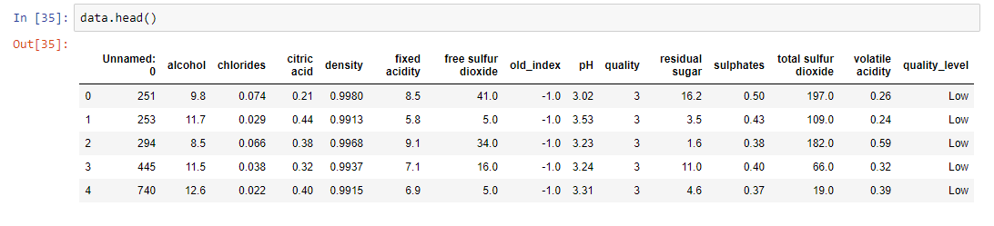
Differentiating high , average and low quality wine
Since we are majorly interested in Quality variable, it makes sense to create another categorical variable called wine rating that will contain ‘low’ (rated from 0-4),‘average’(rated from 5-6) and ’high’(rated 7 or greater) wines.

Slide 19
Data Visualization
Handling Categorical Coded Variable
Univariate Data Analysis
Bivariate Data Analysis
Outliers
Correlation Matrix

Slide 20
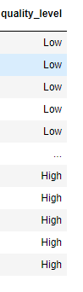
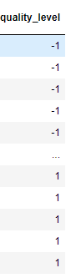
Handling Categorical Coded Variable
Quality level is categorical variable which is distributed in 3 parts i.e High Low and Average.
To remove it we use, 1 for Good quality wine, 0 for average quality wine and -1 for bad quality wine.
Before
After

Slide 21
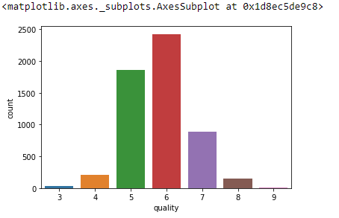
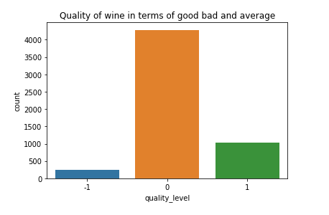
Univariate Analysis
Count plot of Quality and Quality level
We can analyse from the above figure that we have a major part of 5-7 quality range wine and in terms of High , Low and Average we have more quantity of Average wine but we have less data of low quality wine .
Count COunt

Slide 22
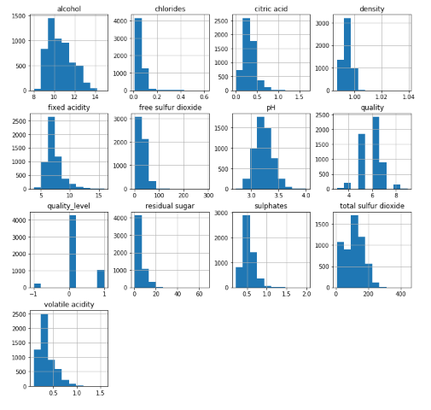
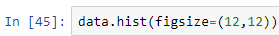
Histogram of all 12 variables
We can see that how our data is distributed among our dataset through histogram like we have wine of majorly 10 ml of alcohol or we have have have 0.8 g/cm^3 density

Slide 23
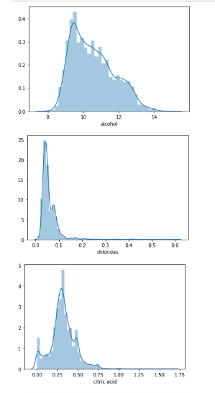
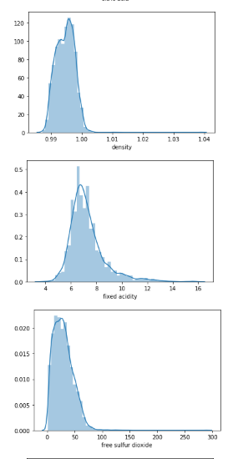
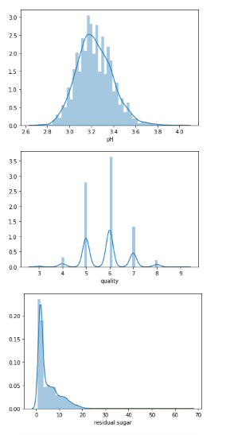
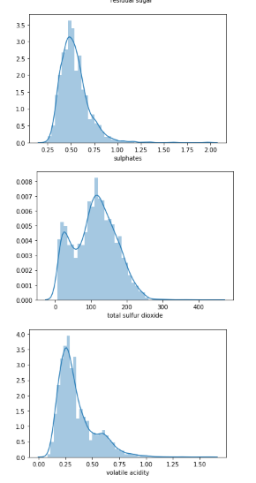
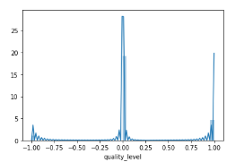
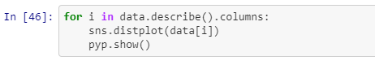
Distplot of all 12 Variables
We can see that all variables are normally distributed with few outliners except
1. Volatile acidity
2. Total Sulfur dioxide
3. Sulphate

Slide 24
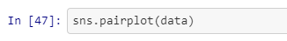
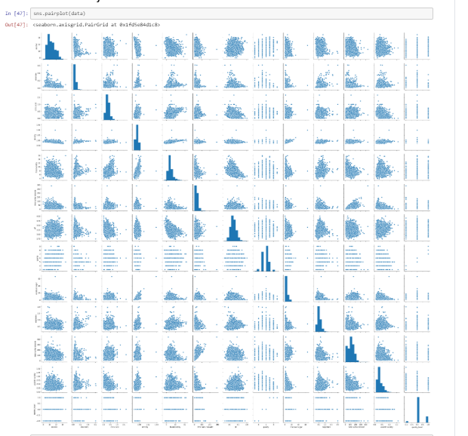
Bivariate Analysis
Pairplot
From the figure we can see that some variables are strongly related to each other such as alcohol and denstiy

Slide 25
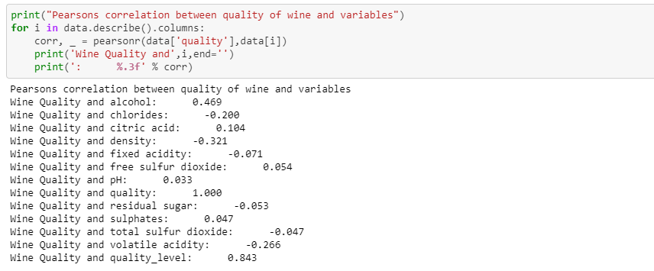
Pearson Correlation b/w Quality and other variables
We can easily see that there is a strong relation between following variables and quality of wine 1. alcohol 2. density 3. volatile acidity

Slide 26
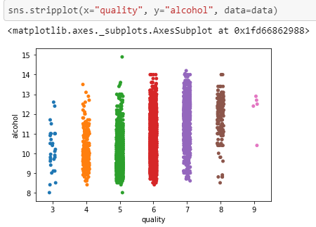
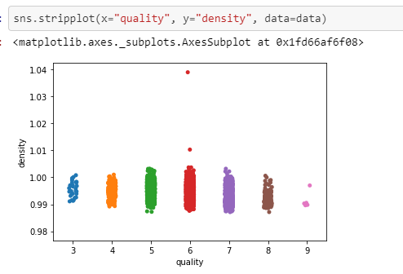
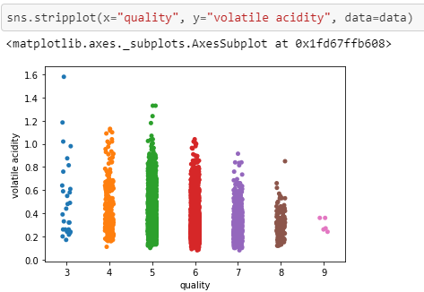
Stripplot between Quality and others important variables
We can now confirm that alcohol , density and volatile acid are strong factors for quality of wine from the above stripplot

Slide 27
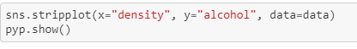
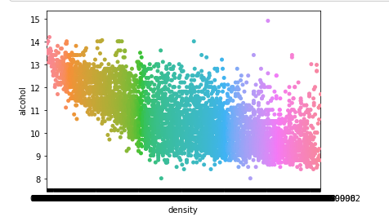
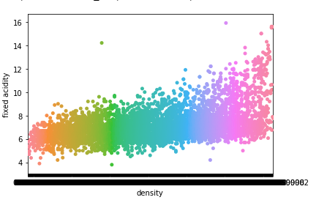
Other important Stripplot between attributesTher
Density VS Fixed acidity
Density VS Alcohol

Slide 28
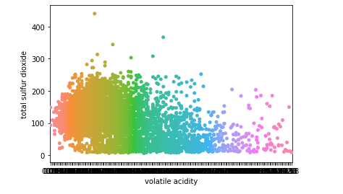
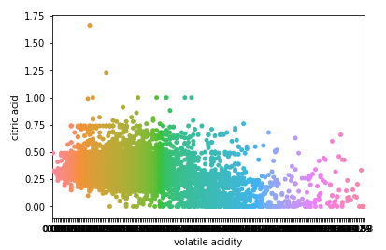
Volatile Acid and Total Sulphur Di Oxide
Citric acid and Volatile Acid

Slide 29
Outliers
•An outlier is an observation that lies an abnormal distance from other values in a random sample from a population. In a sense, this definition leaves it up to the analyst (or a consensus process) to decide what will be considered abnormal. Before abnormal observations can be singled out, it is necessary to characterize normal observations.
•Detection of outliers
1.Outliers using boxplot
2..Outliers using Scatterplot
3.Outliers using z-score
4..Outliers using IQR
5. Percentile Based Outlier function

Slide 30
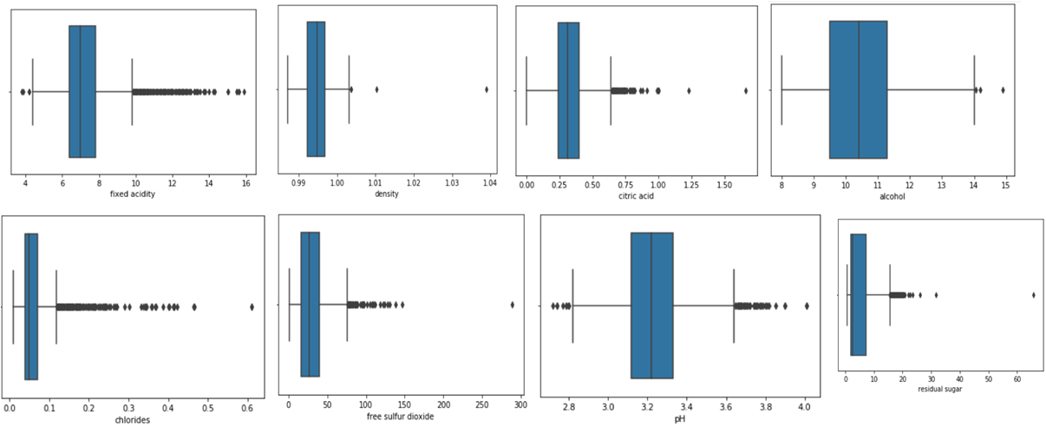
Outliers Using Boxplot
We can see outliers using Boxplot
When reviewing a box plot, an outlier is defined as a data point that is located outside the whiskers of the box plot.

Slide 31
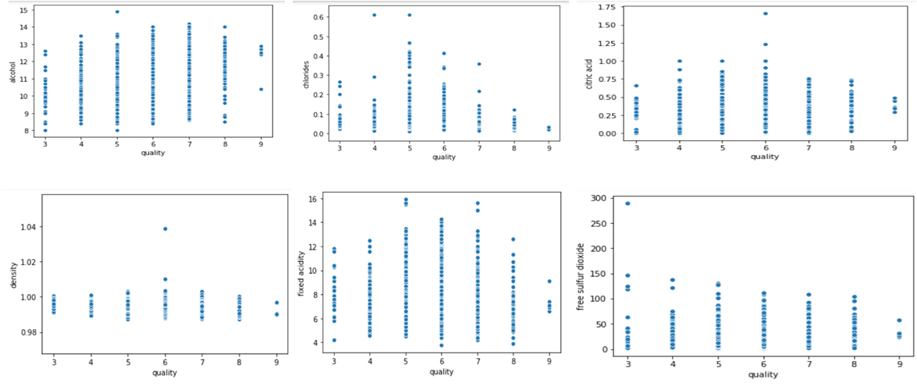
Outliers using Scatterplot
An outlier for a scatter plot is the point or points that are farthest from the regression line.

Slide 32
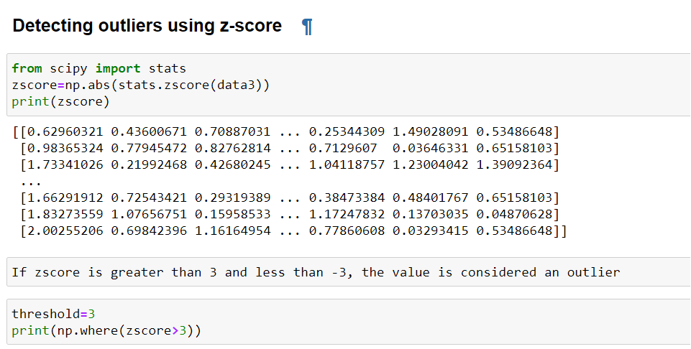
Outliers using Z score
The formula for calculating a z-score is is z = (x-μ)/σ, where x is the raw score, μ is the population mean, and σ is the population standard deviation. ... Z-score formula in a population.

Slide 33
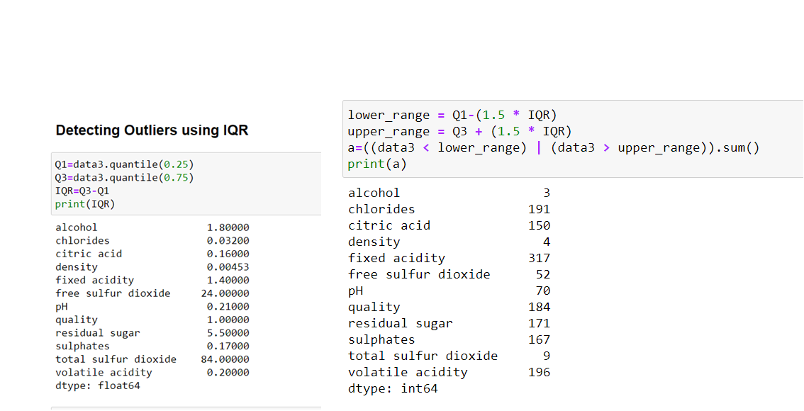
Outliers using IQR

Slide 34
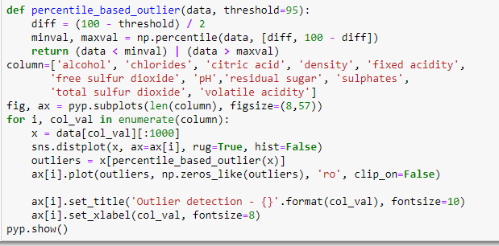
Percentile Based Outlier function
Threshold value is the range that tells us that if our data lies in that range then it will accept it otherwise it will reject it as a outliers will show it has red dots
Now let’s use the quantile method which will give the max and min threshold values from the dataset..There is one value that has more than 95% value it means that is error datapoint.

Slide 35
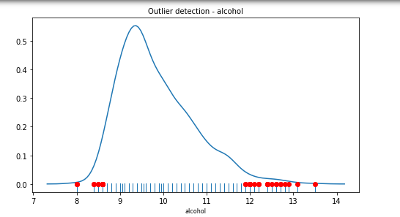
Example of Percentile Based Outlier function
Outliers are red dots which is shown above distplot.

Slide 36
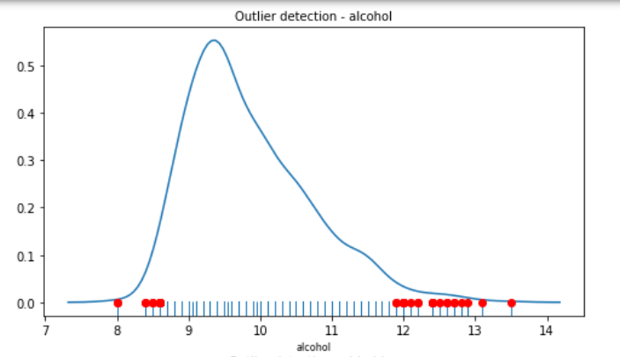










Distplot including Outliers

Slide 37


Correlation matrix

Slide 38

Heat Map

Slide 39
Output from our Analysis
So We have analyse that there are some variables which have a strong effect on our output variables and they are:
Alcohol
Density
Volatile acidity
There are also variables which effect these variables and they are
Chloride
Residual sugar
Volatile acidity
Sulphide oxide

Slide 40
Machine Learning
For this project, we wanted to compare different machine learning models such as following
1. Decision trees
2. Random forests
3. AdaBoost
4. Gradient Boost
5. XGBoost
6. Naive Bayes
7. K-Nearest Neighbours
8. Support Vector Machine Algorithm
For the purpose of this project, we wanted to compare these models by their accuracy.

Slide 41

Spliting Data Into Train and Test data
First we split the dataset into Training data and Test data.
The training set contains a known output and the model learns on this data in order to be generalized to other data later on. We have the test dataset (or subset) in order to test our model's prediction on this subset.

Slide 42

Decision Tree Classifier
A decision tree is a flowchart-like structure in which each internal node represents a “test” on an attribute (e.g. whether a coin flip comes up heads or tails), each branch represents the outcome of the test, and each leaf node represents a class label (decision taken after computing all attributes).

Slide 43


Accuracy from Decision Tree Classifier is 73.74 %

Slide 44

Random forest classifier
It is an ensemble tree-based learning algorithm. The Random Forest Classifier is a set of decision trees from randomly selected subset of training set. It aggregates the votes from different decision trees to decide the final class of the test object.

Slide 45


Accuracy from RandomForestClassifier is 80.43 %

Slide 46

Adaboost classifier
An AdaBoost classifier is a meta-estimator that begins by fitting a classifier on the original dataset and then fits additional copies of the classifier on the same dataset but where the weights of incorrectly classified instances are adjusted such that subsequent classifiers focus more on difficult cases.

Slide 47

Accuracy from Adaboost classifier is 76.76 %

Slide 48

Gradient Boosting Algorithm
Gradient boosting is a machine learning technique for regression and classification problems, which produces a prediction model in the form of an ensemble of weak prediction models, typically decision trees. ... Explicit regression gradient boosting algorithms were subsequently developed by Jerome H.

Slide 49


Accuracy from Gradient Boosting Algorithm is 80.64 %

Slide 50

XGBoost Classifier
XGBoost is an algorithm that has recently been dominating applied machine learning and Kaggle competitions for structured or tabular data. XGBoost is an implementation of gradient boosted decision trees designed for speed and performance.

Slide 51

Accuracy from XGBoost Classifier is 80.43 %

Slide 52

Naive Bayes
Naïve Bayes classifiers are a family of simple "probabilistic classifiers" based on applying Bayes' theorem with strong (naïve) independence assumptions between the features.

Slide 53

Accuracy from Naive Bayes is 70.36 %

Slide 54

K-Nearest Neighbours
The k-nearest neighbors algorithm (k-NN) is a non-parametric method proposed by Thomas Cover used for classification and regression. In both cases, the input consists of the k closest training examples in the feature space. ... In k-NN classification, the output is a class membership.

Slide 55

Accuracy from K-Nearest Neighbours is 78.06 %

Slide 56

Support Vector Machine Algorithm
A support vector machine (SVM) is machine learning algorithm that analyzes data for classification and regression analysis. SVM is a supervised learning method that looks at data and sorts it into one of two categories

Slide 57



Accuracy from Support Vector Machine algorithm is 70.36 %

Slide 58
OUTPUT AFTER APPLYING ML ALGORITHMS
Accuracy from Decision Tree Classifier is 73.74 %
Accuracy from RandomForestClassifier is 80.43 %
Accuracy from Adaboost classifier is 76.76 %
Accuracy from Gradient Boosting Algorithm is 80.64 %
Accuracy from XGBoost Classifier is 80.43 %
Accuracy from Naive Bayes is 70.36 %
Accuracy from K-Nearest Neighbours is 78.06 %
Accuracy from Support Vector Machine algorithm is 70.36 %
From the above code we can see that Gradient Boosting Algorithm gives the best result in terms of accuracy of 80.64 %

Slide 59

Building an Interface
We use django webframe work to build an user interface so that our users can easy check and predict the quality of their wine.
After determining that Gradient Boosting Algorithm has best accuracy we use it to form a pkl file to store it in our database.
Pickle in Python is primarily used in serializing and deserializing a Python object structure. In other words, it's the process of converting a Python object into a byte stream to store it in a file/database, maintain program state across sessions, or transport data over the network.

Slide 60



How interface looks

Slide 61



